Slide 1
WAVELET TRANSFORM

Slide 2
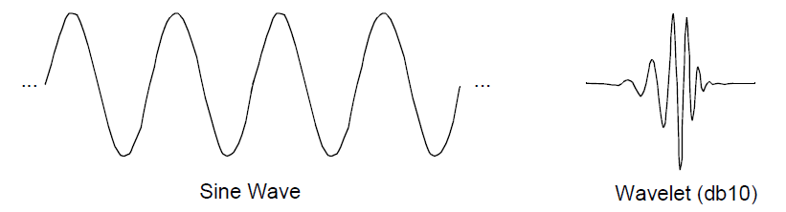
Wavelet Analysis
What are wavelets?
A wavelet is a waveform of effectively limited duration that has an average value of zero
Similar to sinusoids except where sinusoids are smooth and predictable, wavelets tend to be irregular and asymmetric.

Slide 3
Wavelet Analysis(contd.)
Fourier analysis: Breaking up a signal into sine waves of various frequencies
Wavelet analysis: Breaking up of a signal into shifted and scaled versions of the original (or mother) wavelet

Slide 4
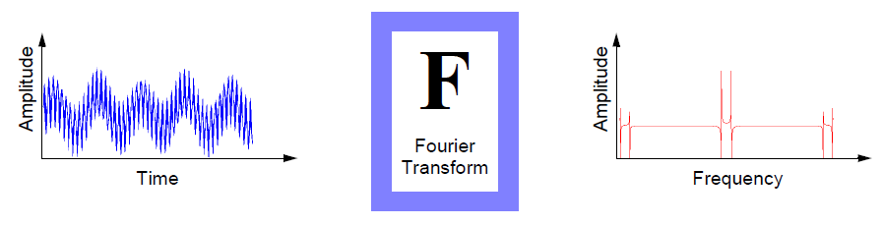
Fourier Analysis
Drawback: In transforming to the frequency domain, time information is lost.

Slide 5
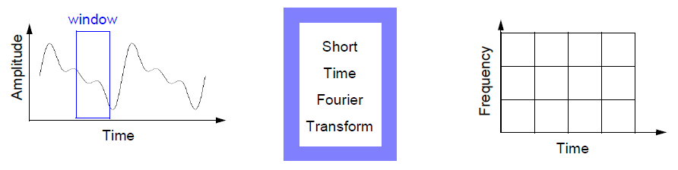
Short-Time Fourier Analysis
The STFT is a sort of compromise between the time and frequency-based views of a signal
Drawback:
(a) Limited precision depending on the size of window
(b) Once we choose a particular size for the time window, that window is the same for all frequencies
Notes:
Developed by Dennis Gabor

Slide 6
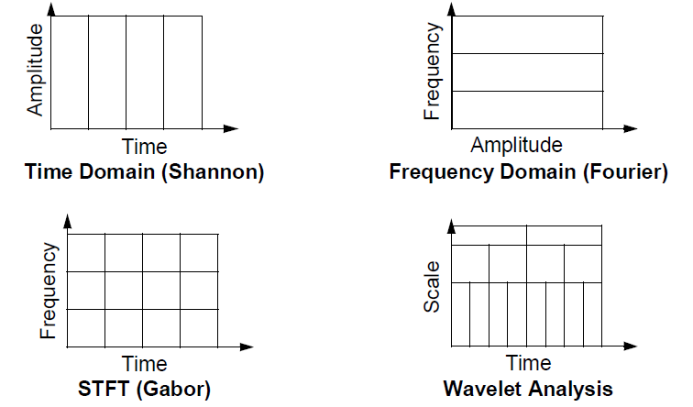
Wavelet Analysis(Revisit)
Next logical step: a windowing technique with variable-sized regions
Notes:
https://www.youtube.com/watch?v=ZnmvUCtUAEE

Slide 7

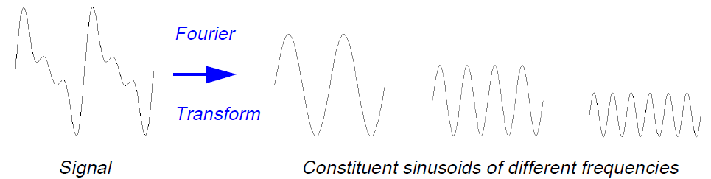
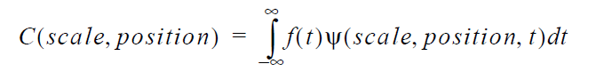
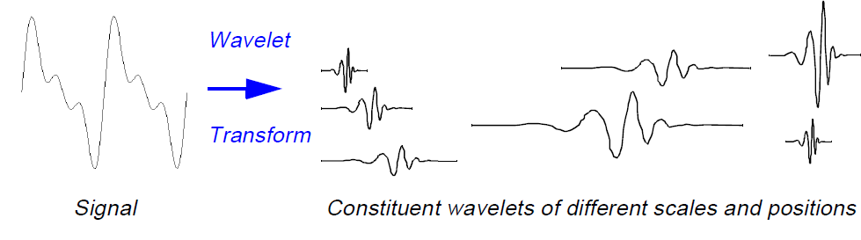
Fourier Analysis:
Wavelet Analysis:

Slide 8
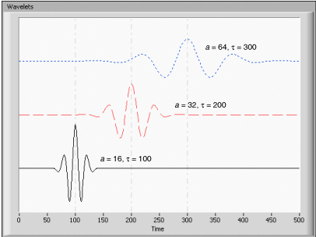
Scale-Frequency Correspondence
Low scale Compressed wavelet Rapidly changing details High frequency
High scale Stretched wavelet Slowly changing, coarse features low frequency
Notes:
Types of Wavelet Transform
CWT
DWT

Slide 9
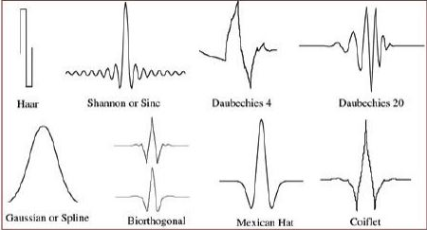
Types of Wavelets
Haar
Daubechies
Biorthogonal
Coiflets
Symlets
Morlet
Mexican Hat

Slide 10
Work Done (So far)
Base line wandering was removed using Wavelet transform. Wavelet Toolbox available in Matlab was used. Daubechies (dB5) wavelet as mother wavelet. Scale level used was 7
RR peaks was then detected on the filtered signal
Frequency domain features were extracted
De-trending the signal and RR peak detection was also implemented on Python

Slide 11
Features Extracted(Frequency domain)
Peak Frequency for VLF,LF and HF range
Absolute power of VLF,LF and HF bands
Relative power of each band
Normalized power of LF and HF band
Ratio between LF and HF band powers

Slide 12
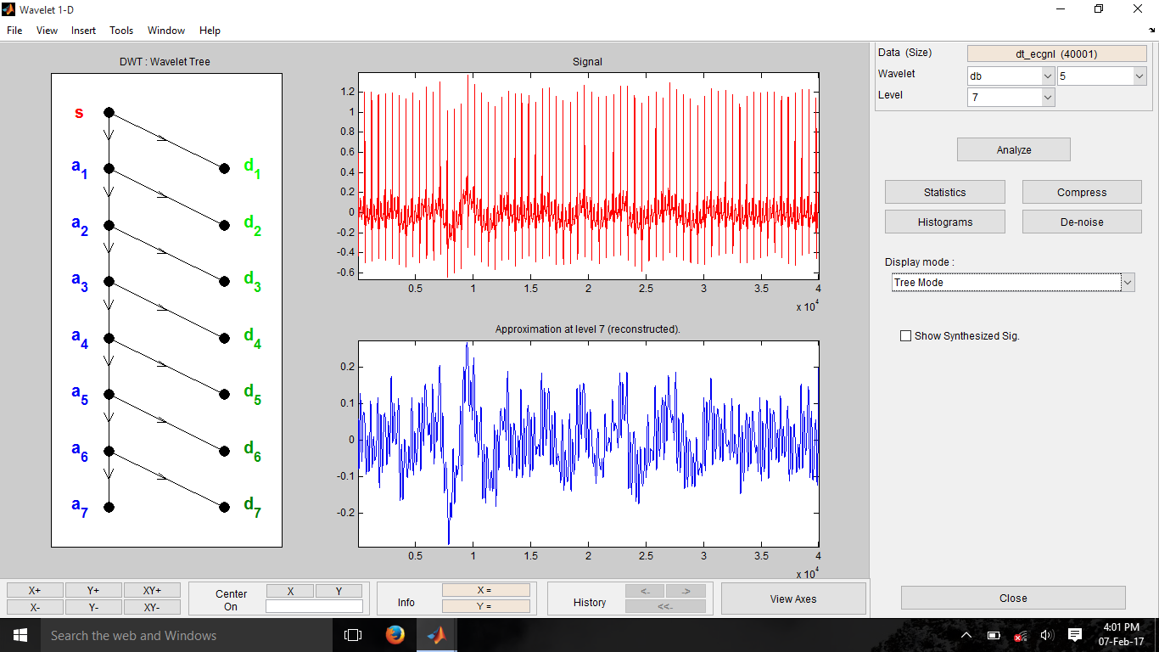
Graphs (Wavelet Toolbox-Matlab)

Slide 13
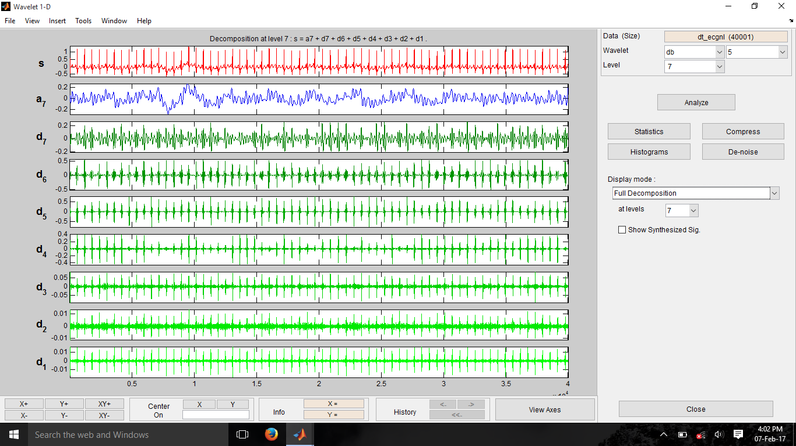

Slide 14
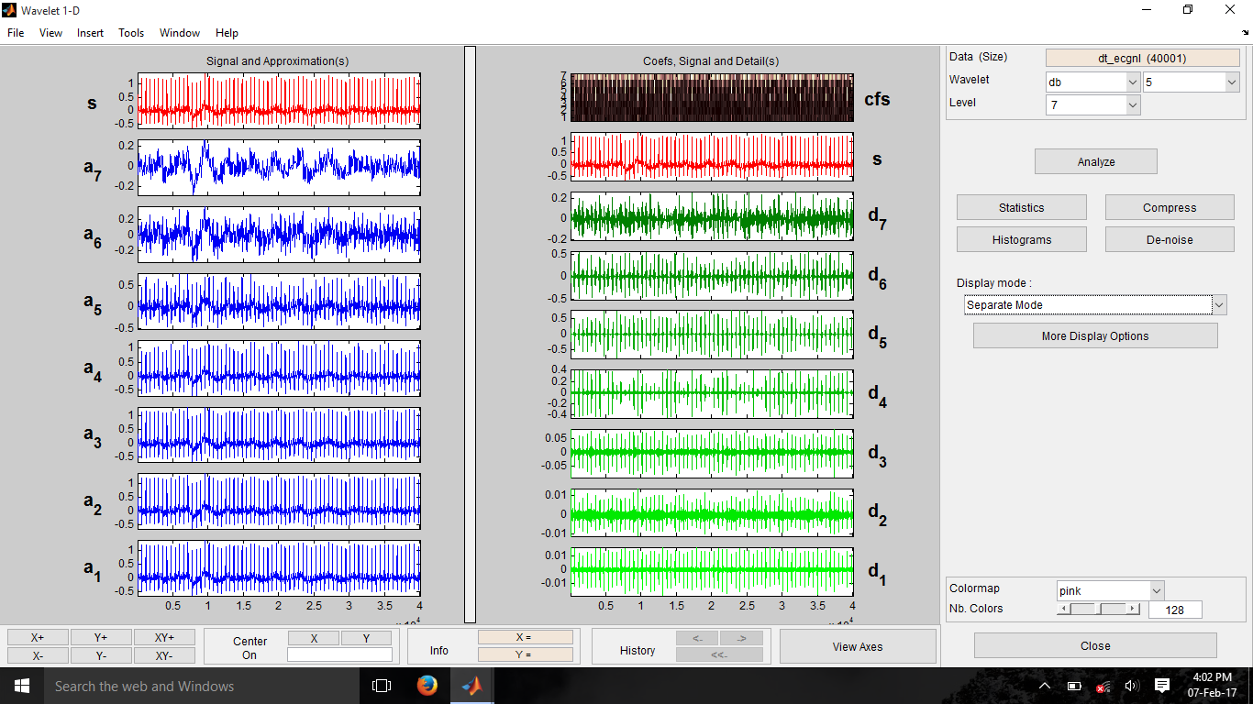

Slide 15
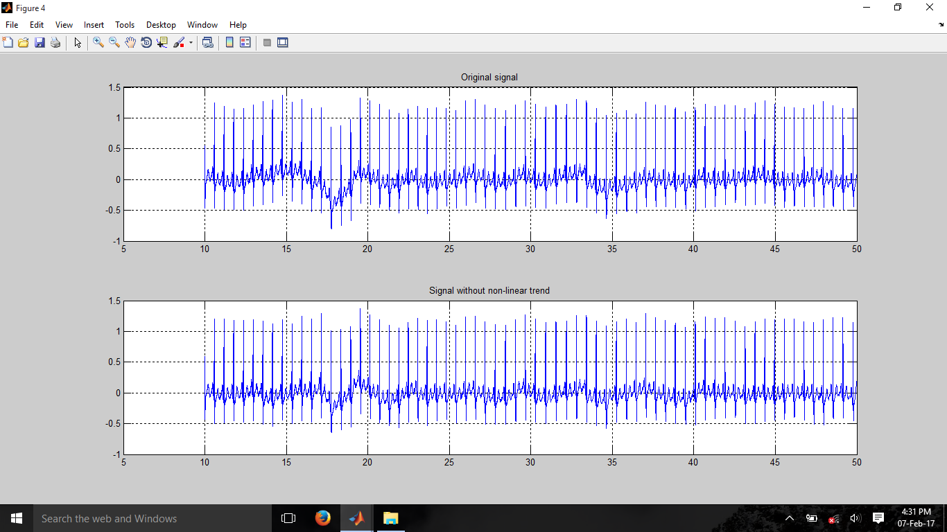
Graphs [Matlab]

Slide 16
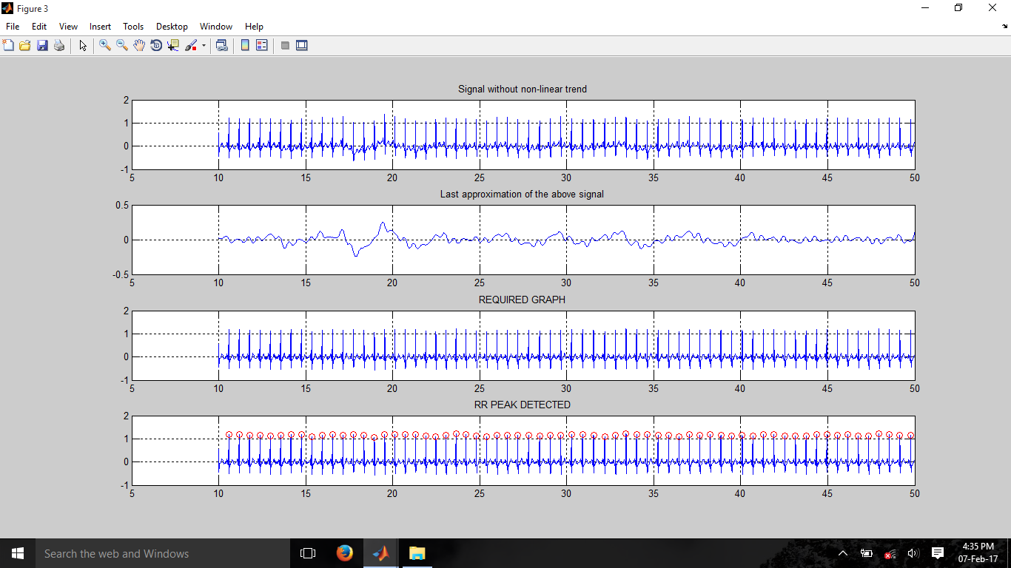

Slide 17
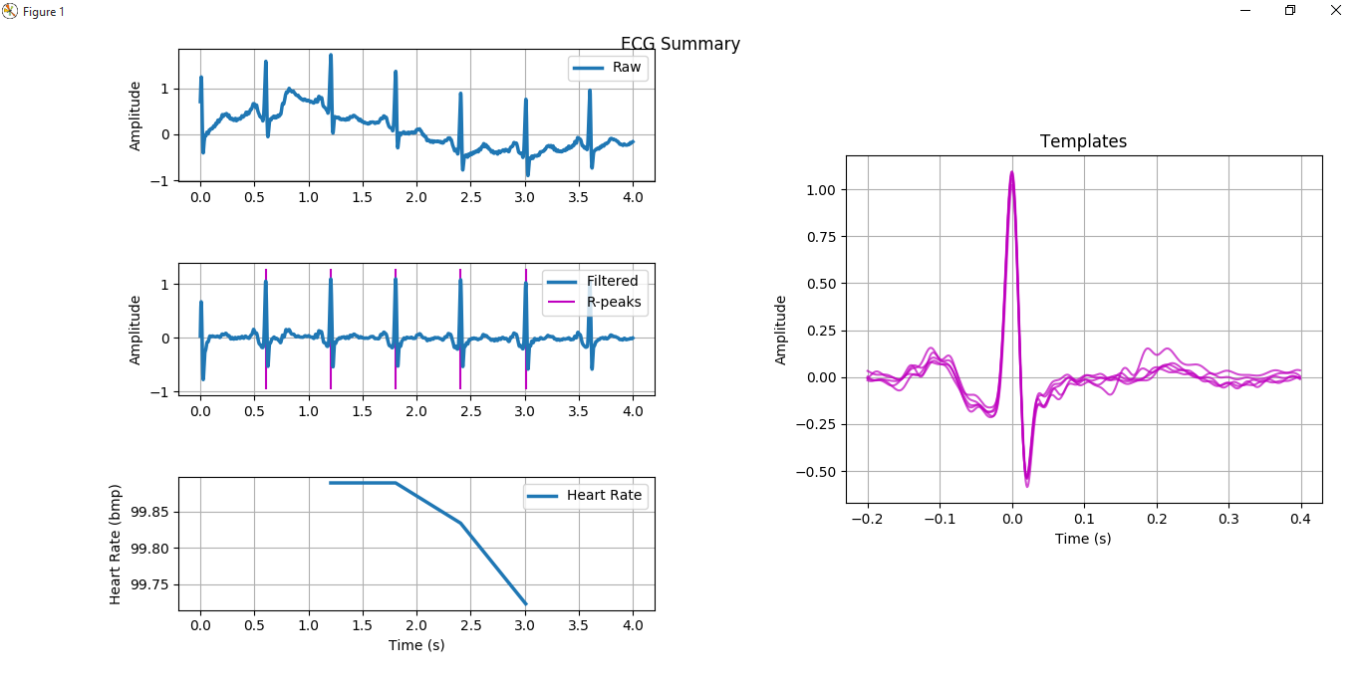
Graph(Python)
Notes:
Module used : biosppy,numpy and matplotlib

Slide 18
Next review targets
Use command line instruction in Matlab script to remove the dependence on toolbox for isolation of scaled signal
Consolidate the data for all the samples available into a csv file
Use the wavelet analysis module instead of biosppy in python
Port the Matlab code to Raspberry-Pi

